Slide 1
Characteristics of Life

Slide 2
Standard: SCSh1. Students will evaluate the importance of curiosity, honesty, openness, and skepticism in science.
Purpose: To understand, in detail what characteristics are needed in order to be considered a living organism
Unit Vocab Words:
Scientific Method | Characteristics of Life | Microscope
Hypothesis Independent Variable Dependent Variable Control Constants Qualitative Quantitative Theory | Homeostasis Organism Unicellular Multicellular Structures Functions Species Offspring DNA Biology | Eyepiece Stage Diaphragm Coarse Adjustment Fine Adjustment Low Power Lens Medium Power Lens High Power Lens

Slide 3
What is Life?
An organism (living thing) is anything that has all characteristics of life
There are 7 characteristics of life and an organism must have all of them to be considered alive.

Slide 4
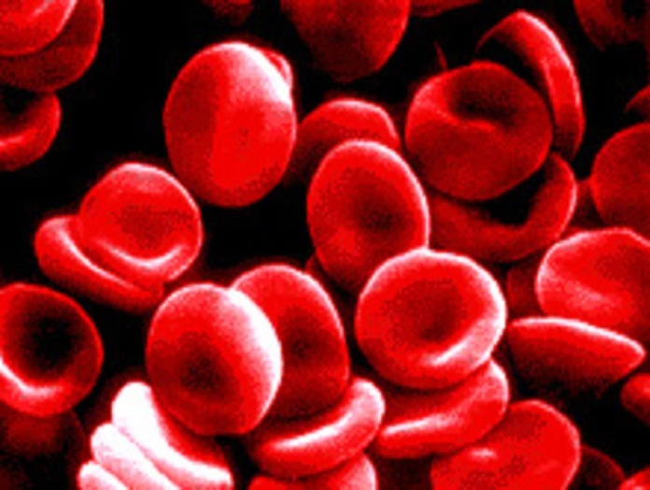
The 7 characteristics of life
Living things:
1) are made up of cells
- organisms made of 1 cell are unicellular
- organisms made of more than one cell are multicellular
2) are organized
- organisms have structures (parts) that have specific functions (jobs)

Slide 5
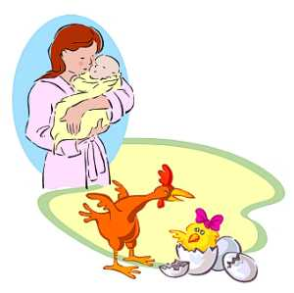
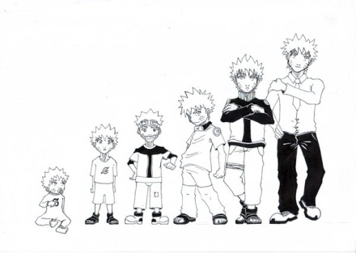
The 7 characteristics of life
3) Reproduce
- organisms produce offspring
- species- organisms that have the ability to reproduce and produce fertile offspring
4) Grow and develop
- grow- to get bigger in size
- develop- to change in appearance

Slide 6
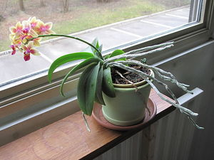
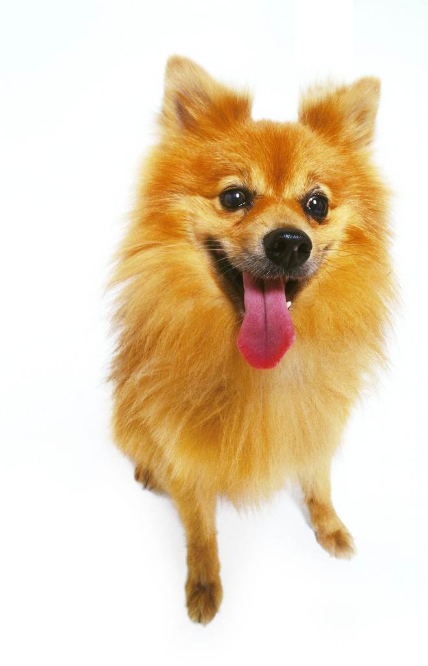
The 7 characteristics of life
5) Respond and adjust to their environment
- homeostasis (homo= same, stasis= state)
- Some organisms have the ability to maintain stable conditions internally even when their external surroundings change. This is maintaining homeostasis.

Slide 7
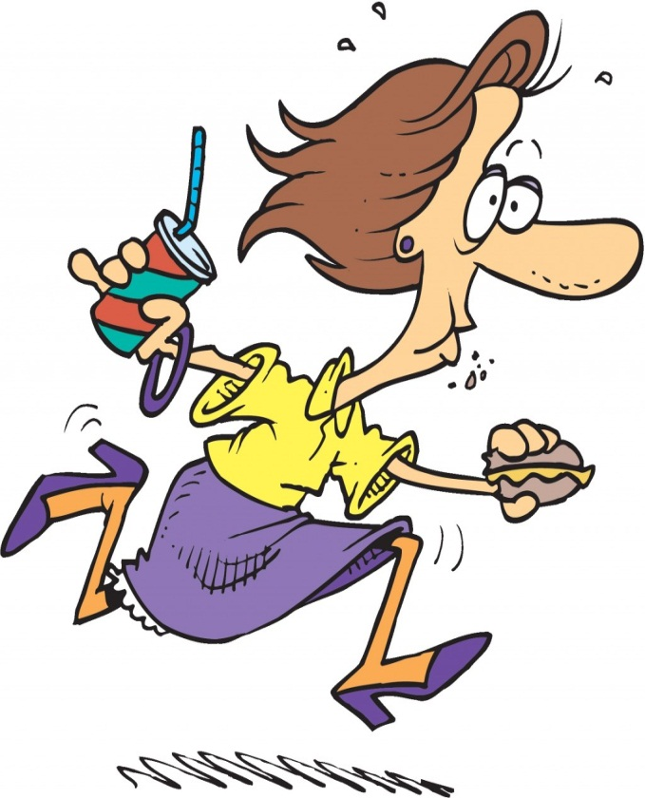
The 7 characteristics of life
6) Obtain and use energy
- Organisms can obtain energy by eating or using the sun to make food
- Organisms use energy to do work

Slide 8
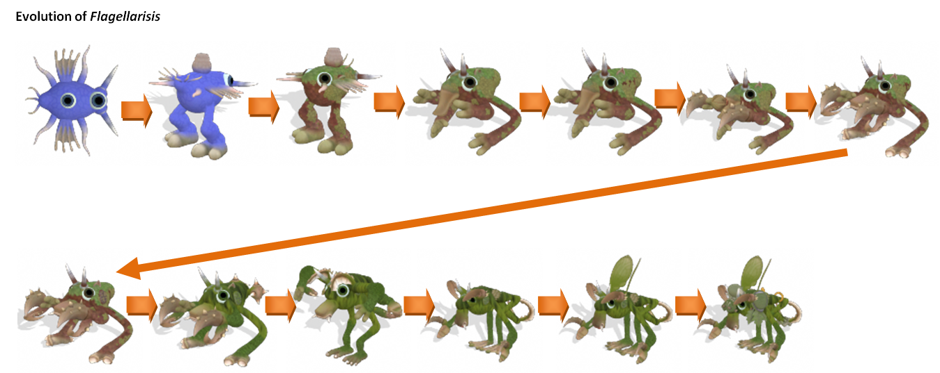
The 7 characteristics of life
7) Adapt and evolve
- Organisms adapt to their surroundings in order to survive
- The evolution of a new species can occur as a result of adaptations

Slide 9
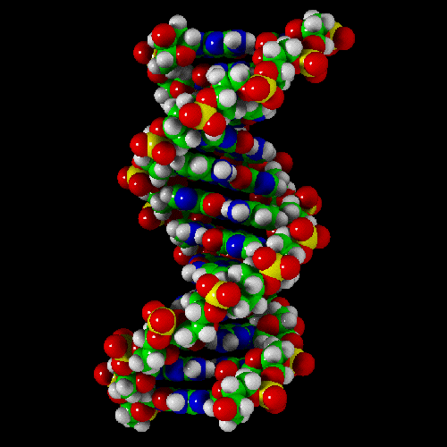
Remember
All organisms have DNA (genetic material)
The study of life is called biology (bio life, logy study of)

Slide 10
CLOSING: Ticket out the door
How would you identify a living organism?
What is the difference between UNIcellular and MULTIcellular?

