Slide 1
Microscope Notes

Slide 2
Standard: SCSh2. Students will use standard safety practices for all classroom laboratory and field investigations.
Purpose: To learn the different parts and functions of a microscope.
Unit Vocab Words:
Scientific Method | Characteristics of Life | Microscope
Hypothesis Independent Variable Dependent Variable Control Constants Qualitative Quantitative Theory | Homeostasis Organism Unicellular Multicellular Structures Functions Species Offspring DNA Biology | Eyepiece Stage Diaphragm Coarse Adjustment Fine Adjustment Low Power Lens Medium Power Lens High Power Lens

Slide 3
Parts of the Microscope
1. Eyepiece (ocular lens)
Function: Magnifies (makes larger) the sample 10x
2. Stage
Function: Holds the slide in place
3. Diaphragm
Function: Varies (changes) the amount of light coming from the lamp
4. Coarse Adjustment
Function: The knob that focuses when using the low-power objective

Slide 4
Parts of the Microscope
5. Fine Adjustment
Function: The knob that focuses when using the medium and high-power objectives
6. Low-power (scanning) objective lens
Function: Magnifies the sample 4x
7. Medium-power objective lens
Function: Magnifies the sample 10x
8. High-power objectives lens
Function: Magnifies the sample 40x

Slide 5
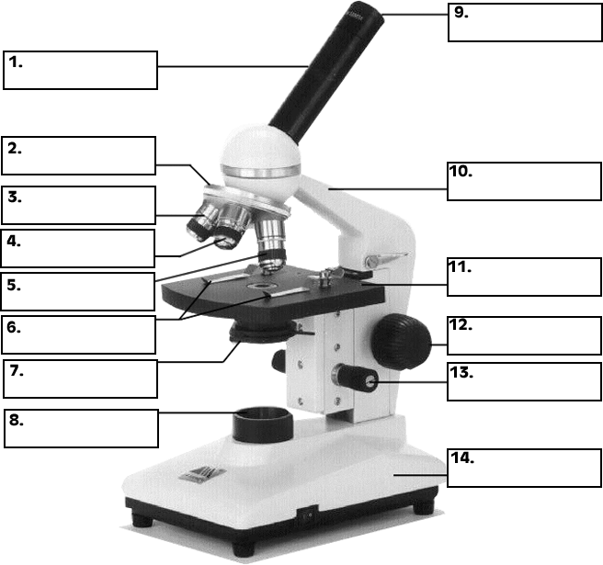
Label the Microscope
Eyepiece
Eyepiece Tube
Rotating Nosepiece
Arm
Low- power lens
Medium-power lens
Stage
High-power lens
Stage Clips
Coarse Adjustment
knob
Diaphragm
Fine Adjustment
Knob
Light source
Base

Slide 6
Calculating TOTAL MAGNIFICATION
Eyepiece magnification x objective magnification = total magnification
Ex. 10x x 4x = 40x

Slide 7
Calculate the total magnification of the following:
eyepiece lens (5x) x low power objective (4x) = ___
eyepiece lens (10x) x high power objective (40x) = ___
eyepiece lens (7x) x medium power objective (10x) = ___
eyepiece lens (10x) x objective (45x) = ___
eyepiece lens (10x) x objective (50x) = ___

Slide 8
Calculate the objective power being used for viewing
eyepiece lens = 10x total magnification = 200x objective power = ____
eyepiece lens = 5x total magnification = 200x objective power = ____
eyepiece lens = 7x total magnification = 280x objective power = ____
eyepiece lens = 5x total magnification = 100x objective power = ____

Slide 9
Mini-quiz-closing
Match the Characteristic of life
Ducks webbed feet allows it to move through water better
Bacteria are unicellular organisms
Eating food will give you energy for the rest of the day.
Moving your hand from a hot pot or pan.
How do you calculate the total magnification of a microscope? (answer using words)

